Slide 1
Build credit:
Understanding credit
Reports and scores

Slide 2
OBJECTIVES
Understand what credit is and why it matters to you.
Distinguish between credit report and credit score.
Describe a credit report.
Recognize factors used to calculate credit scores.
Discuss the ability to obtain and build credit.

Slide 3
Most people borrow money at some point in their lives. True or False: a credit report and credit score only matter if you plan to borrow money.
STUDENT LOANS
CREDIT CARDS
CAR
HOUSE
Notes:
FALSE

Slide 4
Information in your credit report is used to make decisions about you. Your credit report and score matter!
Get a job and/or get security clearance for a job.
Get an apartment, utilities, Internet.
Get insurance.
Purchase a car.
Get a credit card or loan.
Notes:
A poor credit history can make it difficult for you to:
Employers, Lenders, and Service Providers can and will use your credit report to gage how trustworthy and responsible you are
It’s not just about borrowing money

Slide 5
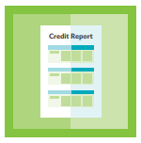
What is a credit report? A credit report is a statement that has information about you and your credit activity, past and present.
EQUIFAX
EXPERIAN
TRANSUNION
Each of the three nationwide credit reporting agencies collects information about you to make their own credit report.
Creditworthiness is a lender’s appraisal of how likely you are to repay your debts.
Notes:
There are 3 versions of your credit report. Determine your creditworthiness.
All credit is a loan; it’s the provision of money with the expectation of future payment.

Slide 6
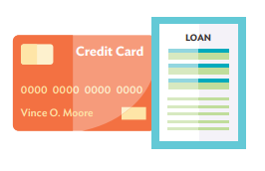
How are credit reports created?
A credit report is created when you open a credit account for the first time and when the creditor reports the information to a credit agency.
Have you applied for a:
Credit card?
Loan?
Are you an Authorized User on a credit card?
If you answered no, then you will most likely not have a credit report.
Notes:
You will not have a credit report because there is no activity to report.

Slide 7
Example Credit Report
Identifying Information
Name(s)
Current and previous address
Social Security Number
Date of birth
Phone number
Employment history
Does not include information such as race or ethnicity
Notes:
Have you seen your own credit report?
Each of the three nationwide credit reporting companies presents information in a slightly different way. This is an example of a credit report that highlights the key sections you’ll find in all three companies’ credit reports.
May also include past addresses associated with your name (ex. parents’ address)
May not include all past jobs.
Make sure all of this information is correct.
Can not use race or ethnicity to determine credit worthiness

Slide 8
Example Credit Report
Public Record Information
Financial public records: bankruptcies*, judgements*, tax liens
Date filed
Any accounts with a collection agency
Status of collection accounts
Records of arrests or convictions
Marriage records
Notes:
Negative information, like a Bankruptcy can appear on your credit report for only a specified period of time – up to 10 years. Judgements, such as back child support payments can appear on your credit report for 7 years or until the statute of limitations has expired, whichever is longer.

Slide 9
Example Credit Report: Fixed Account
Account Information
Open accounts you currently have and closed accounts
Company name and account number
Balance*
Account type (fixed or revolving)
Responsibility: guarantor, co-signer, or authorized user
Date opened
Payment history
Past due: 30, 60, 90 days
Notes:
These are called “trade lines”
Most recent reported balance – accounts are updated every 30 days
This is an example of a “fixed” credit account. The payment amount is the same each month and there is an end payment = a loan

Slide 10
Example Credit Report: Revolving Account
Account Information
Company name and account number
Balance
Credit limit*
Account type (fixed or revolving)
Responsibility: guarantor, co-signer, or authorized user
Date opened
Payment history
Past due: 30, 60, 90 days
Notes:
This is an example of a “revolving” credit account. Both the balance and payment can fluctuate, and there is not an end payment.
*The amount of credit used will affect your credit score.

Slide 11
Example Credit Report: Inquiries
Hard Inquiries:
Made by lenders when you apply for credit
Will affect your credit score
Similar loan related inquiries count as one (45 days FICO, 14 days VantageScore)
Soft Inquiries:
Reviews of your credit file when you have not applied for new credit
Include prescreening by prospective lenders, reviews of existing accounts by lenders, background checks, and your request for your annual free credit report
Will not affect your credit score

Slide 12
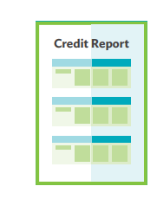
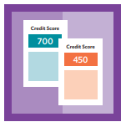
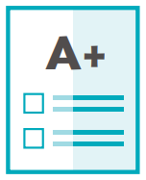
What is a credit score? Credit score is a number that predicts the likelihood that debt will be repaid on time. What is a FICO® Score? - Member Center on Vimeo
GPA is one piece of information colleges look at when determining acceptance.
Credit score is one piece of information creditors look at to determine a borrower’s ability and willingness to repay a loan.
Notes:
What do you already know about credit scores? Do you know what your credit score is?
The higher your score, the less risk you represent.

Slide 13
Credit scores are calculated using the information in credit reports.
EQUIFAX
714
EXPERIAN
709
TRANSUNION
720
Credit scores vary because each company may look at different information about you and use different formulas for calculating your scores. As a result, you have more than one credit score.
90% of lenders use FICO scores in lending decisions.
Notes:
Have you heard of a FICO score? Vantage Score?
Large variance in scores is usually due to reporting discrepancies with each company.

Slide 14
How are credit scores calculated?
Payment History
Paying bills on time and as agreed.
Amount of Debt
Total owed and available credit remaining.
Length of Credit History
How long the account has been open.
Credit Mix
Types of credit used: revolving (credit cards)
fixed or installment (loans).
New Credit
All new accounts opened and credit requests.
Notes:
The way you use and repay debt affects your credit score.
Paying on time and at least the minimum amount due.
Staying below your credit limit helps your score – do not max out your credit cards!
History = Ability to responsibly repay debt over time. Don’t close open accounts in good standing.
Generally, it’s considered a good thing to have a mix of credit, and not too many credit cards.
Too many inquires may signal that you have a high need for credit. This may be an indicator of risk.

Slide 15
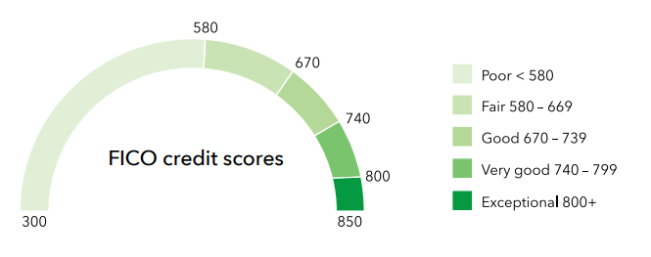
Credit Score Range
Most credit scores range from 300 to 850. A credit score above 700 is considered good by most businesses.

Slide 16
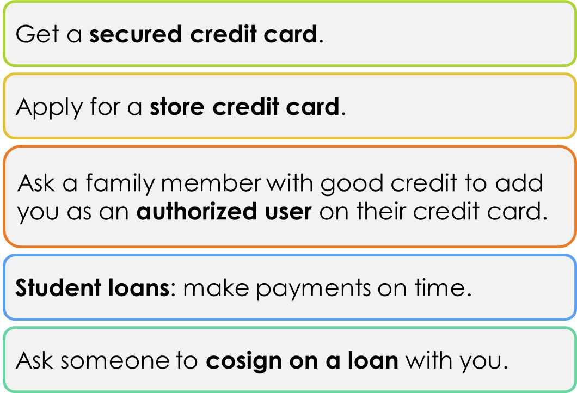
Building Credit
Notes:
Secured credit card – requires putting down a deposit, which typically becomes your credit limit. The deposit does not cover your monthly payments.
Store credit card (or gas card) – often easier to get than general use credit cards. Be sure to pay the balance off every month as retail cards typically charge high interest rates.
Authorized user – you will get your own card to use if the primary card holder agrees; you benefit from their credit history.

Slide 17
Experian Boost
What?
Adds payments like utilities, cell phone, internet, and streaming (Netflix, Hulu) to your Experian credit report.
How?
Create a free Experian account
Connect the bank account used to pay your bills
Experian Boost scans transaction payments and reports only positive payment history
Who?
People who don’t have a strong credit file (few tradelines) and have been making on time payments
Cons
Not beneficial if you already have a strong credit file
Does not affect your credit file with Equifax and TransUnion
Notes:
Other credit builder services –(Experian) UltraFICO score gauges financial behavior by scoring how much you have in savings and whether you incur overdrafts in your checking account
(TransUnion) eCredable Lift reports utility accounts, not free

Slide 18
Experian Go
What?
Program that helps people who are “credit invisible” start building a credit history
How?
Create a free Experian account
Experian offers suggestions for starting credit
Sign up for a starter credit with one of Experian’s partners
Who?
Young adults just learning/starting credit for the first time
People who have recently moved to the US (US issued ID and SSN to sign up)
Notes:
Other credit builder services –(Experian) UltraFICO score gauges financial behavior by scoring how much you have in savings and whether you incur overdrafts in your checking account
(TransUnion) eCredable Lift reports utility accounts, not free

Slide 19
MAKE A PLAN Even if you have never used credit, it is possible that you have been a victim of credit fraud or identity theft.
Request a free credit report from each of the three credit reporting companies at Annual Credit Report.com - Home Page
Review your credit reports every 12 months.
Dispute any errors on your credit reports.
Determine to keep a good credit history. Build habits such as
Paying bills on time, every time
Spend under your credit limit and do not max out credit cards
Moderate credit activity: apply for credit that you need but do not live beyond your means!
Notes:
Request – use the free site. Be ready to answer security questions specific to only you.
Review – look at each section carefully to ensure all information is correct. If you find mistakes…
Dispute – with the credit reporting company. Be prepared to provide documentation. Each company will have procedures for you to follow. Document your activity!
Moderate – credit is good, you need a credit history. But all good things have the potential to turn bad. Be aware of your spending and do not LIVE on credit.

