Slide 1


Preparing to rent an apartment

Slide 2
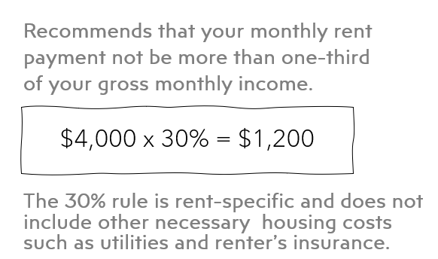


Determine Your Budget
The 30% Rule of Thumb
.
.
.
.
.
.

Slide 3

Understand Upfront Costs
Application Fee/Admin Fee
$50 - $200
Prescreening
Background/credit checks
Security Deposit
Money paid to the landlord that ensures the tenant will pay rent and follow the lease
Usually 1 month’s rent (no limit in Texas)
May be refundable* (document)
Pet Deposit/Fee/Rent
Deposit* $200 to $500
Fee $100 to $500
Pet Rent $25-$50 per pet
Deposit may be refundable*
Fee is non-refundable
First Month’s Rent
Prorated for the partial month you move in
Ex: move in on the 15th you pay rent from the 15th to the last day of the month
Notes:
Application/Admin Fee
Cost depends on location, desirability of the property, landlord’s policies
Prescreening responsible and reliable tenants

Slide 4
List Your Requirements
Know what you need, know what you want, is there a cost?
Neighborhood
Amenities
Close to work?
Public transportation?
Noise level?
Accessibility to entertainment?
Upgraded appliance & countertops
Private patio or balcony
Valet trash service
Laundry – common or in unit?
Storage
Parking
Lifestyle & Pet
Covered or assigned?
Garage?
Street?
Swimming pool
Gym
Clubhouse
Pet playground
Notes:
Application/Admin Fee
Cost depends on location, desirability of the property, landlord’s policies
Prescreening responsible and reliable tenants

Slide 5
Research & Tour
Apartments.com
Zumper
Rent.com
Apartment Guide
Budgeting Golden Rule:
If you can’t afford the rent, don’t look at the apartment!

Slide 6
Utilities: Included or Not?
Electricity
Gas
Water
Sewer
Trash
Wi-Fi
Pest control
Rule of Thumb:
About 7% of your monthly income
How much your utilities are and how you pay them depends on if they are included in your rent, charged separately, or a mix of both. Ask the property manager!

Slide 7
Additional Financial Considerations
UTILITY DEPOSITS
$70 to $150
For utilities not included in rent
RENTERS INSURANCE
~$20 a month
Personal property protects your belongings
Personal liability protects you from accidental damage to property or people
Living expenses should you be displaced
MOVING
Packing boxes/supplies
Professionals or friends?
FURNISHING
Furniture
Towels
Pots/pans/kitchen supplies
Cleaning supplies

Slide 8
Roommate or Not?
A roommate can lessen the financial burden but become a mental burden!
Questions to Ask
Are you a smoker?
Do you have/want pets?
What is your daily schedule?
Are you an early bird or a night owl?
How important is cleanliness to you?
Do you like to cook?
What’s your policy on overnight guests?
Do you like to share?

Slide 9
Gather Your Paperwork
YOU WILL NEED
Know your credit score
Submit your application
Proof of income
  pay stubs
  bank statements
  tax returns
Photo ID
Rental history/references

Slide 10
References
BAD
Other
GOOD
Previous landlords
Property manager
Supervisor or co-worker
Your best friend
Family members
People you don’t know well
Prepare in advance
Letter of reference; contact info
Bad credit: good explanation & financial responsibility
.
.
.

