Slide 1
TEXAS REGIONAL BANK
Money bingo!
Member FDIC

Slide 2
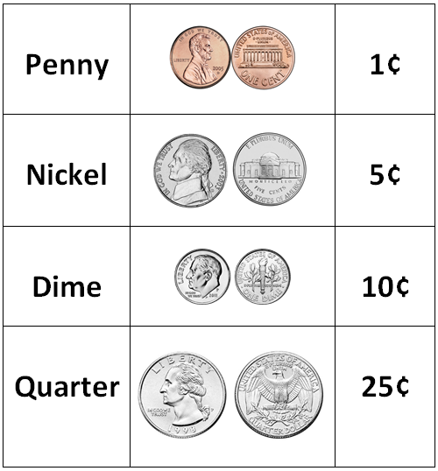
Coin values

Slide 3
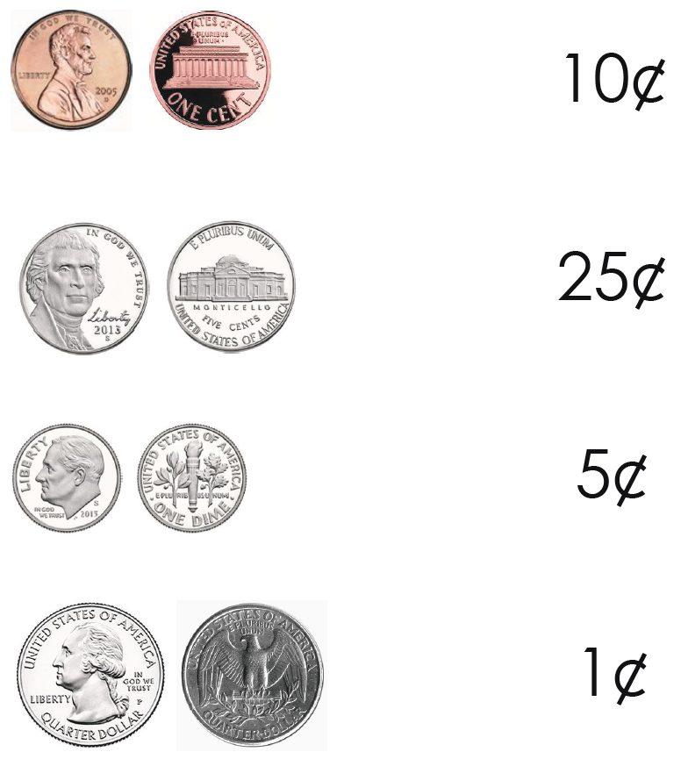
Match each coin with its value

Slide 4
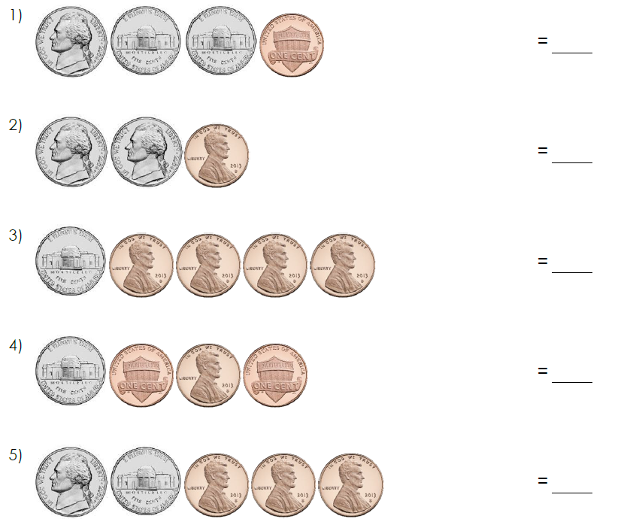
Add the coins and write the total value in cents

Slide 5
