Slide 1
TEXAS REGIONAL BANK
Need or want
Grade K-1
Notes:
Grade level: Elementary school (K–1)
Age range: 5–7
Topic: Spend (Buying things)
Objectives
Understand the difference between needs and wants
Identify things people can buy that are needs and things that are wants
What students will do
Explore the difference between needs and wants.
Play a game where the students decide which items are needs and which are wants.

Slide 2
Big Idea
Understanding how needs and wants are different can help you decide the best way to spend your money.
What is a need?
What is a want?
Notes:
There are things in life that we need and things that we want.
Needs: Things people must have to live or do their work. Food, clothes, a place to live, a way to get to work, and tools are some things people need.
Wants: Things that would be nice to have but that you don’t need to live or do your work.
Sometimes, something that’s a need for one person is a want for another person. For example, some people need a car to get to their job. Other people don’t need a car to get to their job, but they want a car so they can go to places they enjoy.
Understanding what you need and what you want can help you make choices about how to spend money. Before you buy something, it’s a good idea to ask yourself, “Is this something I need or something I want?”
Ask students to share some things they think are needs.
Ask students to share some things they think are wants.
Tell students they’ll play a game where they’ll decide whether something is a need or a want. Explain that you’ll show them pictures of things people can buy.
° They’ll stand if they think the item is a need.
° They’ll stay seated if they think the item is a want.
For each picture:
° Ask one or two students who are standing to share why they think the item is a need.
° Ask one or two students who are sitting to share why they think the item is a want.
° While the item might seem like an obvious need or want to you, be open to students’ reasons for their answers.

Slide 3
Candy
Notes:
WANT

Slide 4
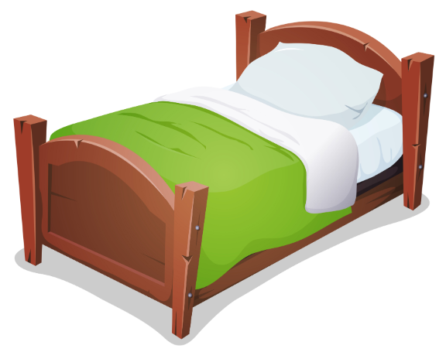
Bed
Notes:
NEED

Slide 5
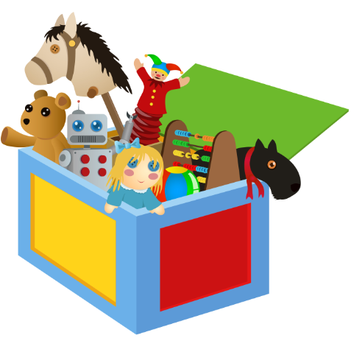
Toys
Notes:
WANT

Slide 6
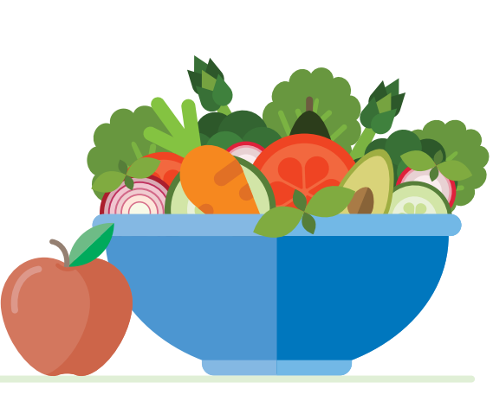
Food
Notes:
NEED

Slide 7
Water
Notes:
NEED

Slide 8
Backpack
Notes:
NEED FOR SCHOOL

Slide 9
Balloons
Notes:
WANT

Slide 10
Pencil
Notes:
NEED FOR SCHOOL

Slide 11
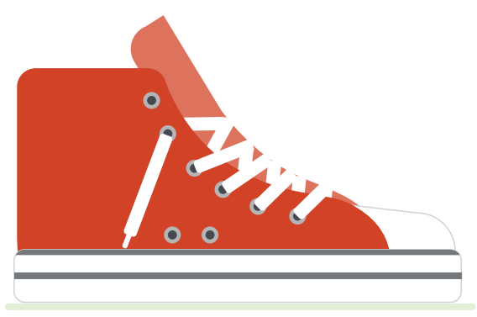
Shoes
Notes:
NEED

Slide 12
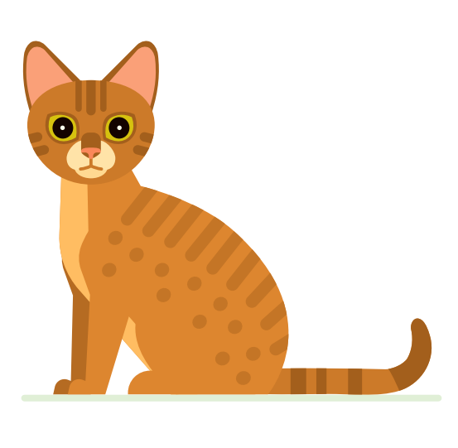
Cat
Notes:
WANT
Wrap-up
Ask students to share if they thought it was easy or hard to decide whether something was a need or a want.
° Tell students that just because something is a want doesn’t mean it’s not important.
For example, a family may want a pet. That’s not something they need to survive, but maybe it’s important to all of them to have a pet to play with and learn how to take care of.

