Slide 1
Banking 101

Slide 2
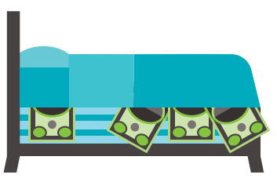
What’s wrong with this picture?
Why Use a Bank?
Convenience
More options for paying: debit card, checks, automatic bill pay, digital wallet apps.
Reduce the need to carry large amounts of cash (safety).
Direct deposit payroll checks from employer.
Complete online transfers and pay for items online.
Track your spending.
Access cash from an ATM.
Saving
Create an emergency fund for irregular expenses like car repairs.
Save for large purchases.
Safety
Banks protect against theft. Money in banks is insured by the U.S. Government.
The Federal Deposit Insurance Corp. (FDIC) insures bank account owners for up to $250,000.
The National Credit Union Administration (NCUA) insures credit union account owners for up to $250,000.
Notes:
Safety
Storing your cash at home isn’t safe: theft, fire, flood. The most secure place to put your money is in a bank account.
Convenience
Money kept in a bank account is accessible anywhere: in person at the local branch, online transactions, from an ATM
Saving
Make regular deposits to savings account for unexpected or irregular expenses, save for large purchases or education = self discipline

Slide 3
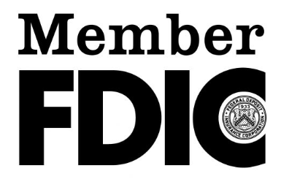
What is FDIC Insurance??
If your federally insured bank fails, your money is protected by the federal government via the Federal Deposit Insurance Corp. (FDIC)
The FDIC insures up to $250,000 per depositor, per institution, and per ownership category.
The FDIC was established in 1933 in response to the many bank failures during the Great Depression.
Per depositor = one person
Per institution = one insured bank
Per ownership category = who owns the account
Ex. An account is co-owned by two people is insured up to $250,000 per person for a total of $500,000
FDIC insurance covers deposit accounts and other official items such as cashier’s checks and money orders.
If a bank is federally insured, it will display the FDIC insurance logo.
FDIC insurance does not cover:
Investments in stocks, bonds, or mutual funds
Losses incurred from investments, even if they were purchased from an insured bank
Life insurance policies
Banks aren’t insured by default
They must apply for FDIC insurance

Slide 4
Types of Banks: Physical or Digital
Traditional Bank
A bank that has physical locations.
Online Bank
A bank that delivers products and services remotely through electronic channels.
Credit Union
A nonprofit depository institution that is owned by members.
Notes:
Traditional
A broad range or services with options to interact in-person.
Online
No physical branches, generally fewer services and higher interest rates.
Credit Union
Usually require membership

Slide 5
Opening a Bank Account
Valid, government-issued photo ID
Personal details
birthdate, social security or taxpayer ID number
driver’s license
passport
Questions to Ask:
Services offered?
Fees charged?
Minimum opening balance?
Minimum monthly balance?
Interest paid?
Number of ATMs and branches?
FDIC or NCUA insured?
Initial deposit
Signature
opening balance
initial agreements, signature on file
.
Notes:
You will need to provide identification and contact information, an initial deposit, and your signature

Slide 6
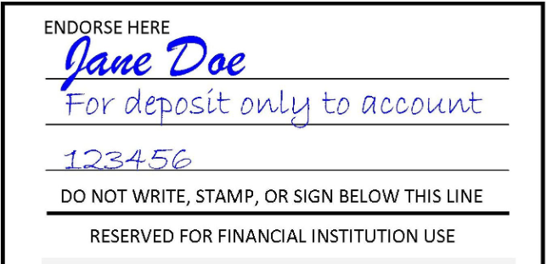
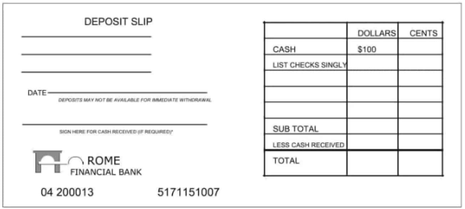
Making Deposits
Check endorsement
Deposit slip
In Person at a Branch
At an ATM
On Your Phone
Direct Deposit
Electronic Transfer
Notes:
If you don’t make deposits, your account will run out of money.
Checks – when you receive a check to deposit you will need to endorse the check by signing your name on the bank. The bank will reject any check that is not endorsed.
Deposit slip – fill in the deposit slip accordingly (check, cash, or both)
Mobile Deposit
Many banks have mobile apps that allow you to use your phone’s camera to snap a photo of the front and endorsed back of the check, type in the check amount, and tell the app which accounts to deposit the check to.
Direct Deposit
If your employer offers, provide your bank account info to your employer, makes life easier, funds should be available on payday
Electronic Transfers
Between financial institutions, PayPal, Venmo, etc.

Slide 7
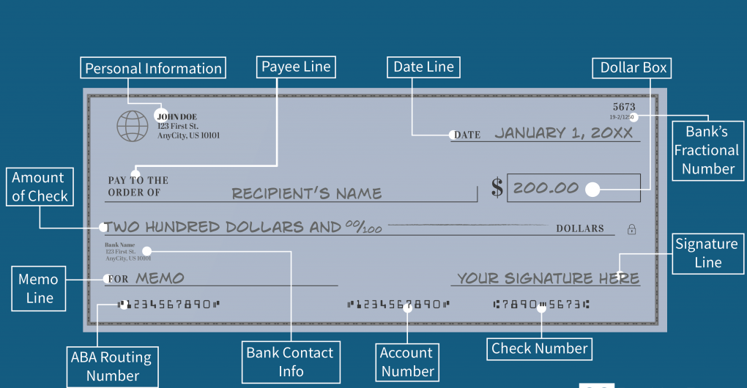
How to Write a Check
Notes:
Date the check
Who is the check for – name of person or company you want to pay
Write the payment amount in numbers – clearly so the amount can be read electronically
Write the payment amount in words – make sure cents are over 100
Write a memo – optional but helpful, ex. “rent”
Sign your name using the signature you used when you opened the checking account

Slide 8
OVERDRAFT SERVICES
OVERDRAFT FEES
debit card purchases
ATM transactions
automatic bill payments
checks
An overdraft occurs when you don’t have enough money in your account to cover a transaction, but the bank pays the transaction anyway.
If you overdraw your account, you must pay back those funds.
Check
your account
daily!
Overdrafts are paid from money in your linked savings account at the same bank.
$ transaction fee $
Bank allows you to spend more money than you have in your checking account, but at a cost for each transaction.
$ transaction fee $

