Slide 1

Budgeting for needs and wants
Grade 6-8
Notes:
Grade level: Middle school (6-8)
Age range: 11-14
Objectives
Differentiate between needs and wants in daily decision-making
Consider how needs and wants influence spending decisions
What students will do
Identify the difference between needs and wants.
Practice making budget choices based on needs and wants.

Slide 2

Big Idea
Understanding the difference between needs and wants can help you make responsible spending decisions.
How can you tell the difference between a need and a want?
How does understanding the difference between needs and wants help you make financial decisions?
Notes:
There are things in life that we need and things that we want. Understanding the differences between needs and wants helps you make a budget to manage your spending and informs your daily spending choices.
Covering all your needs before you spend money on your wants is a wise financial habit.
Needs: Basic things people must have to survive (such as food, clothing, and shelter), resources they may need to do their jobs (such as reliable transportation and the tools of the trade)
Wants: Things that would be nice to have but that you don’t need to live or do your work.
Sometimes, something that’s a need for one person is a want for another person. For example, some people need a car to get to their job. Other people don’t need a car to get to their job, but they want a car so they can go to places they enjoy.
Before you buy something, it’s a good idea to ask yourself, “Is this something I need or something I want?”

Slide 3
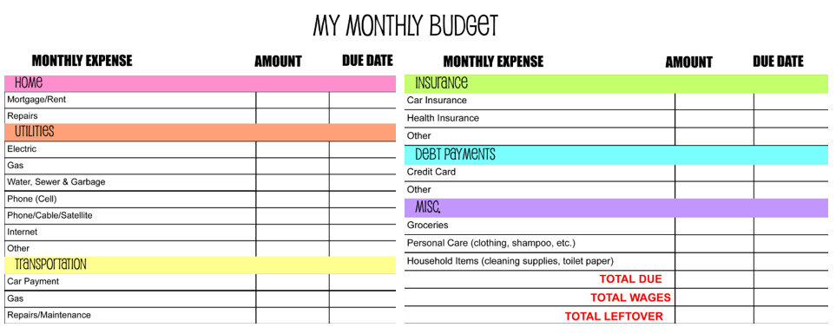
What is a budget?
Budget: A plan that outlines what money you expect to earn or receive (your income) and how you will save it or spend it (your expenses) for a given period.
Notes:
Ask students if they have ever heard anyone say they couldn’t buy something because it wasn’t in their budget. Ask them to explain what they think that phrase means.

Slide 4
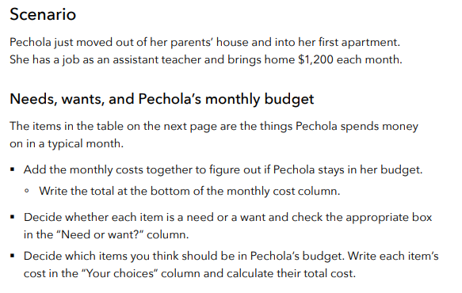
Does Pechola need help with her budget?
Notes:
Help Pechola With Her Budget
Distribute the “Budgeting for needs and wants” worksheet
Read the scenario to the class
Students will work independently to complete their worksheet
Students will then calculate the total cost of the items Pechola spends money on each month to see if she stays within her budget.
Students will decide whether each item is a need or a want.
Students will decide which items they think Pechola should spend money on each month and calculate the items’ total cost.
Students will then answer the reflection questions.

Slide 5
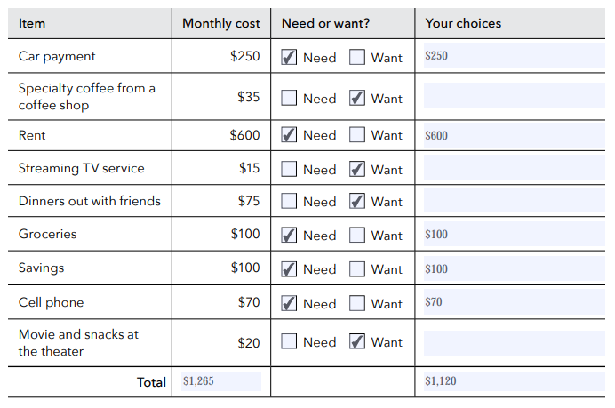
Pechola’s budget
Notes:
Did Pechola stay within her budget?
Bring the class back together and ask for volunteers to share how they categorized the items.
Ask for volunteers to share their responses to the reflection questions.
Did you stay within Pechola’s budget?
If so, was it hard to stay within Pechola’s budget? Why or why not?
If not, which item(s) could Pechola do without to stay within her budget?
If this were your budget, which items would you select?

