Slide 1


Presented by Cesar Suarez
6.24.24

Slide 2

Responding to the Challenge
The Chairman’s Vision
Deliver consumer loans within 1 hour
Deliver small business loans approvals within 48 hours
Deliver commercial loan approvals within 5-7 days
Resulting Initiatives
Reduce U/W effort on renewals under $400k
Automate consumer lot loan renewals
Increase BLA limits
Build a scalable, efficient loan platform
Notes:
Make sure the audience gets awareness of business today and the risks of NOT changing. This is the What’s in it for them in making the change.
Key messaging for Speaker (information taken from your change characteristics document)
“Currently, our processes are decentralized, which creates inefficiencies and slows down decision-making.”
“Our reporting process is manual and requires constant monitoring and maintenance. It is not real-time, and the basic reporting functions do not give us the insights we need to make informed decisions.”
“Financial tracking is also manual and decentralized, which makes it harder to maintain accuracy and consistency across the organization.”
“These challenges impact our ability to serve clients effectively and to operate as one unified organization.”

Slide 3
Drivers for this Change
Loan policy- While our policy is comprehensive, at 202 pages plus exhibits, it is challenging for lenders to fully engage with.
Decentralized forms & applications require users to know where to locate them and to re-key data often.
Forms & Applications
Application- PDF - AFR Flood Cert- manual
F/S collection- email, folders, BME - Policy waivers- word to PDF
CAR- Excel to PDF - Booking worksheet- word to PDF
Approval- Baker Hill, Excel, Word, PDF - Loan terms- Compliance One
Debt-Deposit Recap- Excel, Word, PDF - Doc Prep- manual
CBR- Manually generated - Booking- manual
OFAC- Manually generated
Notes:
Make sure the audience gets awareness of business today and the risks of NOT changing. This is the What’s in it for them in making the change.
Key messaging for Speaker (information taken from your change characteristics document)
“Currently, our processes are decentralized, which creates inefficiencies and slows down decision-making.”
“Our reporting process is manual and requires constant monitoring and maintenance. It is not real-time, and the basic reporting functions do not give us the insights we need to make informed decisions.”
“Financial tracking is also manual and decentralized, which makes it harder to maintain accuracy and consistency across the organization.”
“These challenges impact our ability to serve clients effectively and to operate as one unified organization.”

Slide 4
Reporting Efficiency
Reports
Lender Pipeline, Call Tracking
Credit Administration Pipeline, FPY tracking
Commercial R/E, Commercial Non-R/E, Consumer Non-R/E Pipelines
Challenge
Reporting is manual, tracked via spreadsheets
Usually outdated or a point in time
Requires continuous staff & management effort
CRM to track prospect calls
Clarity on SLAs
Notes:
Make sure the audience gets awareness of business today and the risks of NOT changing. This is the What’s in it for them in making the change.
Key messaging for Speaker (information taken from your change characteristics document)
“Currently, our processes are decentralized, which creates inefficiencies and slows down decision-making.”
“Our reporting process is manual and requires constant monitoring and maintenance. It is not real-time, and the basic reporting functions do not give us the insights we need to make informed decisions.”
“Financial tracking is also manual and decentralized, which makes it harder to maintain accuracy and consistency across the organization.”
“These challenges impact our ability to serve clients effectively and to operate as one unified organization.”

Slide 5
Financial Tracking
Challenge
Email/scan → Personal share drive → CAR Folder → Credit Folder
→ Goldstar Ticket → BME
1,500 new/renewed loans x 7 financial docs = 10,500
F/S journey has 6 TRB homes → 63,000 docs traded internally
Solution
One single repository for financial statements & tracking
Eliminate trading financial documents between departments
Eliminate F/S exceptions for documents we already have on file
Notes:
Make sure the audience gets awareness of business today and the risks of NOT changing. This is the What’s in it for them in making the change.
Key messaging for Speaker (information taken from your change characteristics document)
“Currently, our processes are decentralized, which creates inefficiencies and slows down decision-making.”
“Our reporting process is manual and requires constant monitoring and maintenance. It is not real-time, and the basic reporting functions do not give us the insights we need to make informed decisions.”
“Financial tracking is also manual and decentralized, which makes it harder to maintain accuracy and consistency across the organization.”
“These challenges impact our ability to serve clients effectively and to operate as one unified organization.”

Slide 6







Why Abrigo?
Centralize the loan process configured to TRB’s loan policy
Automate financial requirements, loan structure & pricing
Route approvals to the appropriate channels
Automate Reporting
Centralize financial statement and tracking efforts
Gain efficiency via integrated third-party vendors
Single workflow will eliminate the re-keying of data
Automate doc prep & loan booking
Position TRB for the future
Notes:
Make sure the audience gets awareness of business today and the risks of NOT changing. This is the What’s in it for them in making the change.
Key messaging for Speaker (information taken from your change characteristics document)
“Currently, our processes are decentralized, which creates inefficiencies and slows down decision-making.”
“Our reporting process is manual and requires constant monitoring and maintenance. It is not real-time, and the basic reporting functions do not give us the insights we need to make informed decisions.”
“Financial tracking is also manual and decentralized, which makes it harder to maintain accuracy and consistency across the organization.”
“These challenges impact our ability to serve clients effectively and to operate as one unified organization.”

Slide 7
Our Project Team
Role | Contact
Executive Sponsors | Cesar Suarez Brent Baldree Michael Lamon
Project Manager | Gregg Booth
Sageworks Admin/Champion | Chris Villarreal
Lending SMEs | Cesar Suarez Laura Villarreal
Credit Underwriting SMEs | Jessica Adame Gaby Garza
Operations/Admin SMEs | Rebecca Rodriguez Ricki Wilson Marie Deleon Cassandra Jasso Ed Bird
Report Writers | Michael Elsik Ronda Johnson
Notes:
Note for TRB – Confirm list, double check spelling
Want to introduce our project team.
You can go to them for questions you might have about the project. We may or may not have the answer, but we will track one down for you.
Role​ Responsibilities​
Project Manager​
Hold the project team accountable for an on-time and successful project. Setup regular internal meetings to review homework and decision making.
Sageworks Admin/Champion​
Long term role past implementation that handles all changes to configuration post roll-out. Works to gain a deep understanding of anything and everything in the system so that any proposed changes do not negatively impact other areas of the system.
Lending Subject Matter Experts​
Functional experts of lending that will aid in designing and configuring system.
Credit Underwriting Subject Matter Experts​
Functional expert of Credit that will aid in designing and configuring system.
Operations/Admin Subject Matter Experts​
Functional experts of Operations that will aid in designing and configuring system.
Integration Subject Matter Experts​
Ensuring our Core Data is mapped over to Sageworks appropriately and feeds in each morning.

Slide 8











TRB | Implementation Timeline
Planning
September/October 2025: TRB assembled a project team and began laying out the goals and needs
Core Integration
December 2025 – March 2026: Our files from the Core will come over every morning into Abrigo to give us the most up to date information
Train the Trainer
May 2026: Subject Matter Experts attend Train the Trainer to prepare for launching end user training across the bank
Go Live Rollout
Summer 2026: All new Commercial deals begin running through Abrigo
SBA Training
May 2026: End users, specific to SBA, will be trained on SBA modules
System Design
Oct 2025 – Jan 2026: TRB Project Team works with Abrigo to use best practices to design the system to meet our unique needs
System Validation
January - March 2026: Finalize product configurations and testing for Commercial. SBA Configuration/Validation
End User Training Rollout
Summer 2026: All users will receive robust training and time to practice
Notes:
Speak high level about the implementation timeline, what the different phases are and what happens in each phase. The goal is to provide insight into what the implementation process is and how long it will last

Slide 9
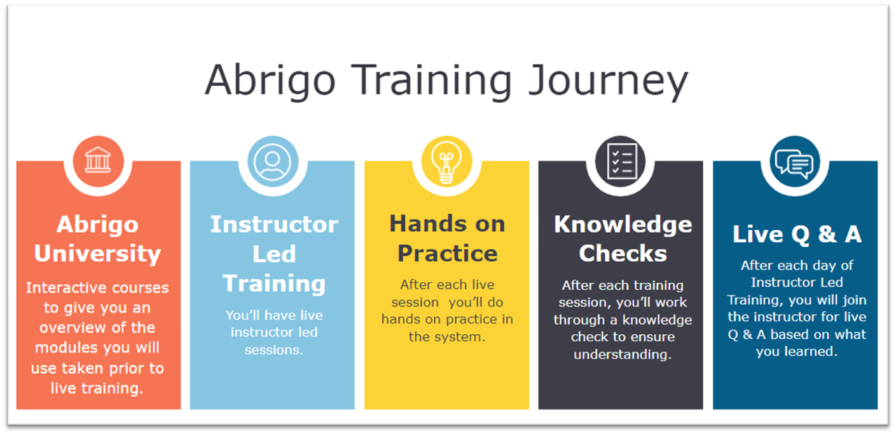
What about Training?
Notes:
We will go through a robust training journey. When the time comes (closer to end of Q2, early Q3), we will start with Abrigo University where you can watch on demand and live courses to become familiar with the basics. Then we will move to Instructor Led Training by your peers where we dive into the specifics of how to use the system for your role. From there we will provide plenty of practice time and knowledge checks so you can be sure you’re prepared to use it. We will then make sure we have regular Q & A sessions to answer any questions that come up!
There will be updates and more to come on training as we get closer to that milestone.

Slide 10
Keeping Up with the Project
Look
Look for emails from myself and project team
Read
Check out our Abrigo Implementation Monthly Newsletter
Check
Check the Intranet for past newsletters, training information, and more!
Watch
Look for demos and other live content coming your way

