Slide 1
TEXAS REGIONAL BANK
Abrigo Loan Origination
Town Hall # 2
February 25, 2025

Slide 2

Agenda
Why We Must Change
Where We Are in the Journey
Staying Connected & Informed
Live Walkthrough of our Dynamic Application

Slide 3

Responding to the Challenge
The Chairman’s Vision
Deliver consumer loans within 1 hour
Deliver small business loans approvals within 48 hours
Deliver commercial loan approvals within 5-7 days
If we do not modernize our loan platform, we will not be able to meet these expectations consistently. And when we can’t meet them, our competitors will.
If we do not change:
We cannot scale efficiently
We will remain dependent on manual tasks
SLA goals will be inconsistent
Competitors will move faster
Notes:
Make sure the audience gets awareness of business today and the risks of NOT changing. This is the What’s in it for them in making the change.
Key messaging for Speaker (information taken from your change characteristics document)
“Currently, our processes are decentralized, which creates inefficiencies and slows down decision-making.”
“Our reporting process is manual and requires constant monitoring and maintenance. It is not real-time, and the basic reporting functions do not give us the insights we need to make informed decisions.”
“Financial tracking is also manual and decentralized, which makes it harder to maintain accuracy and consistency across the organization.”
“These challenges impact our ability to serve clients effectively and to operate as one unified organization.”

Slide 4
Drivers for this Change
Today, a single commercial deal can touch 20+ systems (spreadsheets, emails, folders, PDFs, manual reports) and requires multiple handoffs. This is not a people issue – it’s a platform issue.
Forms & Applications
Application- PDF - AFR Flood Cert- manual
F/S collection- email, folders, BME - Policy waivers- word to PDF
CAR- Excel to PDF - Booking worksheet- word to PDF
Approval- Baker Hill, Excel, Word, PDF - Loan terms- Compliance One
Debt-Deposit Recap- Excel, Word, PDF - Doc Prep- manual
CBR- Manually generated - Booking- manual
OFAC- Manually generated
Notes:
Make sure the audience gets awareness of business today and the risks of NOT changing. This is the What’s in it for them in making the change.
Key messaging for Speaker (information taken from your change characteristics document)
“Currently, our processes are decentralized, which creates inefficiencies and slows down decision-making.”
“Our reporting process is manual and requires constant monitoring and maintenance. It is not real-time, and the basic reporting functions do not give us the insights we need to make informed decisions.”
“Financial tracking is also manual and decentralized, which makes it harder to maintain accuracy and consistency across the organization.”
“These challenges impact our ability to serve clients effectively and to operate as one unified organization.”

Slide 5
Manual Tracking → Real-Time Reporting
Today, most of our reporting is manual. It lives in spreadsheets; it is updated periodically. And often, it reflects a point in time — not real time reality.
That means:
Pipeline reporting requires continuous manual updates.
Management spends time reconciling numbers.
Lenders spend time explaining where deals are.
Internal production teams are distracted from production.
We work hard to maintain visibility. Reporting should reflect our efforts; reporting should not be the effort.
Notes:
Make sure the audience gets awareness of business today and the risks of NOT changing. This is the What’s in it for them in making the change.
Key messaging for Speaker (information taken from your change characteristics document)
“Currently, our processes are decentralized, which creates inefficiencies and slows down decision-making.”
“Our reporting process is manual and requires constant monitoring and maintenance. It is not real-time, and the basic reporting functions do not give us the insights we need to make informed decisions.”
“Financial tracking is also manual and decentralized, which makes it harder to maintain accuracy and consistency across the organization.”
“These challenges impact our ability to serve clients effectively and to operate as one unified organization.”

Slide 6
Financial Tracking
Financial statement journey
Email/scan → Personal share drive → CAR Folder → Credit Folder
→ Goldstar Ticket → BME
Last year alone, we internally moved over 60 thousand financial documents between departments. That is friction. That is time. That is capacity lost.
Notes:
Make sure the audience gets awareness of business today and the risks of NOT changing. This is the What’s in it for them in making the change.
Key messaging for Speaker (information taken from your change characteristics document)
“Currently, our processes are decentralized, which creates inefficiencies and slows down decision-making.”
“Our reporting process is manual and requires constant monitoring and maintenance. It is not real-time, and the basic reporting functions do not give us the insights we need to make informed decisions.”
“Financial tracking is also manual and decentralized, which makes it harder to maintain accuracy and consistency across the organization.”
“These challenges impact our ability to serve clients effectively and to operate as one unified organization.”

Slide 7







What does this mean for you?
One workflow. One System.
Loan policy embedded into the process
Less re-keying of data
One workflow instead of multiple systems
One financial tracking system.
Automated pipelines, real-time reporting
Integrated doc prep & booking
Positions TRB for the future
Notes:
Make sure the audience gets awareness of business today and the risks of NOT changing. This is the What’s in it for them in making the change.
Key messaging for Speaker (information taken from your change characteristics document)
“Currently, our processes are decentralized, which creates inefficiencies and slows down decision-making.”
“Our reporting process is manual and requires constant monitoring and maintenance. It is not real-time, and the basic reporting functions do not give us the insights we need to make informed decisions.”
“Financial tracking is also manual and decentralized, which makes it harder to maintain accuracy and consistency across the organization.”
“These challenges impact our ability to serve clients effectively and to operate as one unified organization.”

Slide 8











TRB | Implementation Timeline
Planning
September/October 2025: TRB assembled a project team and began laying out the goals and needs
Core Integration
December 2025 – March 2026: Our files from the Core will come over every morning into Abrigo to give us the most up to date information
Train the Trainer
May 2026: Subject Matter Experts attend Train the Trainer to prepare for launching end user training across the bank
Go Live Rollout
Summer 2026: All new Commercial deals begin running through Abrigo
System Design
Oct 2025 – Jan 2026: TRB Project Team works with Abrigo to use best practices to design the system to meet our unique needs
System Validation
January - March 2026: We are testing the system as if it were live – so that you aren’t the ones finding the issues.
End User Training Rollout
Summer 2026: All users will receive robust training and time to practice
Notes:
As the red star shows, we are currently in the Validation phase of the project.
This phase serves as a controlled environment for testing and confirming that the workflows, templates, integrations, and user roles function exactly as expected within our institution’s processes.
The objective of this phase is to
Ensure functionality accuracy
Confirm data integrity
Validate users access and roles
Begin to simulate real-world scenarios by running test deals
Identifying and resolving issues sooner than later
The next phase will be Train the Trainer.
In mid May, a dedicated group of TRB team members will participate in a 3-day Train-the-Trainer event, led by Abrigo. This training is designed to equip our internal resources with the knowledge and tools to guide other end users through Sageworks.
After Train the Trainer, our teams will be preparing to rollout end user training and Go Live this summer

Slide 9





What about Training?
Abrigo University
Instructor Led Training
Train the Trainer
Post Training Resources
Interactive Courses to give you an overview of the modules you will use taken prior to live training.
You’ll have live instructor led sessions hosted by a trained internal subject matter expert.
We will have internal resources by department to support you during the transition.
We’ll offer Office Hours & 1:1 support.
You’ll receive a resource guide and have access to internal subject matter experts for questions.
Notes:
What Training Will Look Like and How We Will Support You
1. Abrigo University
Before live training, you will complete short, interactive courses in Abrigo University.
These courses are designed to give you a solid overview of the system and the modules you will use in your role.
Think of this as setting the foundation so live training feels familiar instead of overwhelming.
This prework helps everyone come into training with a shared baseline and more confidence.
2. Instructor Led Training with Our Internal Team
You will participate in live, instructor led training sessions led by trained internal subject matter experts.
These are people who understand both the system and how TRB works day to day.
This is your opportunity to ask questions, hear real examples, and connect the system to your actual work.
Training is structured, but interactive, and focused on what you need to do your job well.
3. Hands On Practice During Training
Training will not just be listening or watching.
You will have hands on practice in the system during training sessions.
This is where learning really sticks and where questions naturally come up.
You are encouraged to try things, make mistakes, and build comfort while support is right there.
4. Post Training Support and Ongoing Resources
Training does not end when the session ends.
After training, you will have access to office hours and one on one support if you need extra help.
You will also receive a resource guide and have continued access to internal subject matter experts.
Our goal is to make sure you feel supported not just at go live, but as you build confidence over time.
We are committed to setting you up for success with the right training, practice, and support.
This is not about perfection on day one. It is about learning, building confidence, and knowing help is available when you need it.

Slide 10
Our Project Team
Role | Contact
Executive Sponsors | Cesar Suarez Brent Baldree Michael Lamon
Project Manager | Gregg Booth
Sageworks Admin/Champion | Chris Villarreal
Lending SMEs | Cesar Suarez Laura Villarreal Margie Rebollar
Credit Underwriting SMEs | Jessica Adame Gaby Garza
Operations/Admin SMEs | Rebecca Rodriguez Ricki Wilson Marie Deleon Cassandra Jasso Ed Bird
Report Writers | Michael Elsik Ronda Johnson
Notes:
Note for TRB – Confirm list, double check spelling
Remind people of who they can contact for information about the project if they have questions.
One of the survey questions asks “I know who I can contact or where to find additional information about the new system and the upcoming change.”
Remind them at the end of each Newsletter the project team is listed

Slide 11
How we will keep you informed.
Emails
Look for emails from myself and project team
Newsletters
Check out our Abrigo Implementation Monthly Newsletter
Info Hub
Check the Intranet for past newsletters, training information, and more!
E-Learning
Look for demos and other live content coming your way
Notes:
Remind people of where they can find information about the project if they have questions.
One of the survey questions asks “I know who I can contact or where to find additional information about the new system and the upcoming change.”
Ensure people know where to look for information.
Newsletters
Discussions should be happening in the Relationship Manager meetings, Credit Analysts meetings and Loan Processor Meetings
If you have other internal communications being dispersed about the implementation, where is that information housed? How can people access? Are you putting information on the internal website, landing page, SharePoint?
You can house your presentations and Newsletters in these areas to make finding information easy

Slide 12
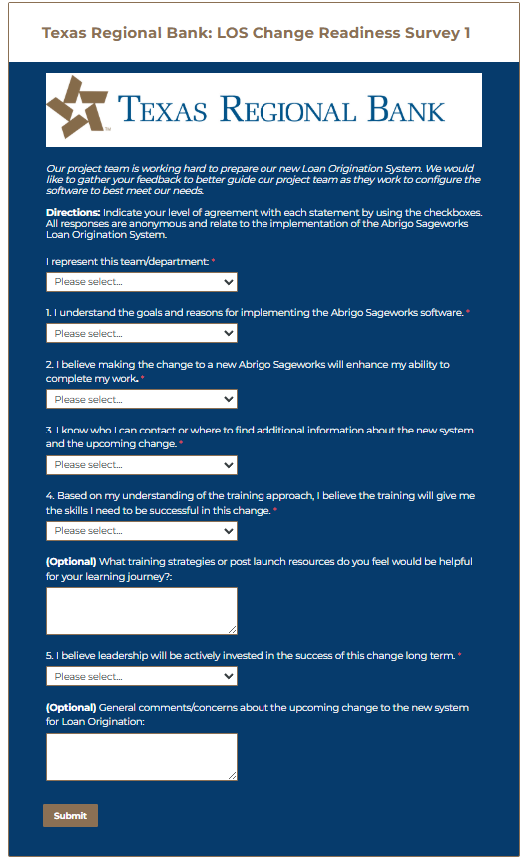
Survey
When: Wednesday, Feb 25th
Who: All lending staff
How: An email will be sent from Cesar following this afternoon
Follow Up: We will share high-level themes from the survey and how we plan to respond.
Notes:
We want to hear from you. This change impacts us all. Your input helps us understand where support is needed and how we can succeed together.
On, XXXX you’ll receive an email from Caesar with a survey. We’d like to get a pulse for how everyone is feeling at this stage and as we move to prep for training all of you.
This is a short, anonymous survey and we encourage you to participate. I want to reiterate, the survey is anonymous so please feel welcomed to express your comments, questions and concerns there if you’re not comfortable doing so in this town hall environment.
There will be two open feedback spaces for you to leave general comments.
We’ll be using your feedback to adapt our approach to communications and other resources to make this change a smooth experience, so everyone feels informed, supported and that your voice is heard.

Slide 13

Live Demo
Dynamic Loan Application by Christopher Villarreal

